Slide 1
PROJECT TITLE Secure Data hiding in images using steganography
CAPSTONE PROJECT
Presented By:
Student Name : Mahesh Jadhao
College Name & Department : National Forensic Sciences University

Slide 2
OUTLINE
Problem Statement
Technology used
Wow factor
End users
Result
Conclusion
Git-hub Link
Future scope

Slide 3
Problem Statement
In the age of digital communication, protecting the privacy and security of sensitive data is crucial. While standard encryption methods protect data during transmission, they frequently draw attention and are vulnerable to discovery. Steganography, or the method of concealing data within other data, provides a more discrete option for safe information transmission. Despite their effectiveness, several steganographic techniques are susceptible to detection, data loss, and poor image quality. The goal of this project is to provide a secure and efficient technique of hiding critical data within photographs while keeping the host image's integrity and quality. The goal is designing a durable steganographic system that properly embeds data into an image without visible distortion, while simultaneously ensuring the embedded

Slide 4
Technology used
Windows Operating System
Python programming language

Slide 5
Wow factors
Data is hidden in pictures by invisible data embedding, which makes no observable alterations.
Dual Security: For twofold protection, steganography and encryption are used. Avoid detection by sophisticated steganalysis techniques by using Stealth Against Detection.
Minimal distortion and high data capacity allow for the embedding of enormous volumes of data without sacrificing image quality.
Real-World Applications: Useful applications in digital rights management, cybersecurity, and the military.
Advanced Algorithms: To improve performance, sophisticated algorithms and machine learning are used.
Innovative Statistical Techniques: Employs sophisticated image processing techniques to covertly conceal data.

Slide 6
End users
Government & Military: For covert communication and secure data exchange.
Cybersecurity Professionals: To protect sensitive data during transfer.
Businesses: For intellectual property protection and digital rights management.
Journalists & Activists: To securely share sensitive information in high-risk environments.
Digital Forensics Experts: For investigating hidden data in digital files.
Cryptographers: For developing advanced security and encryption methods.
Communication Platforms: For secure data transfer and privacy protection.

Slide 7
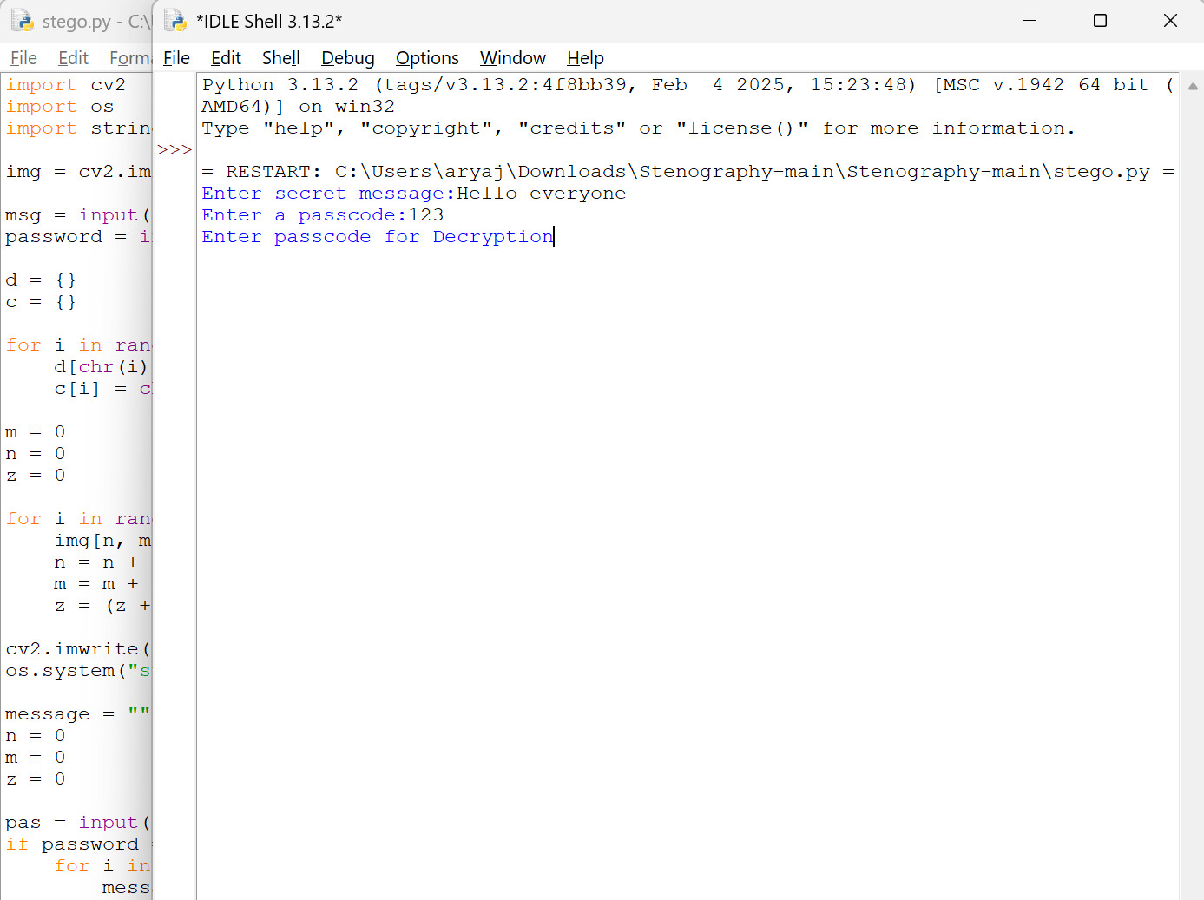
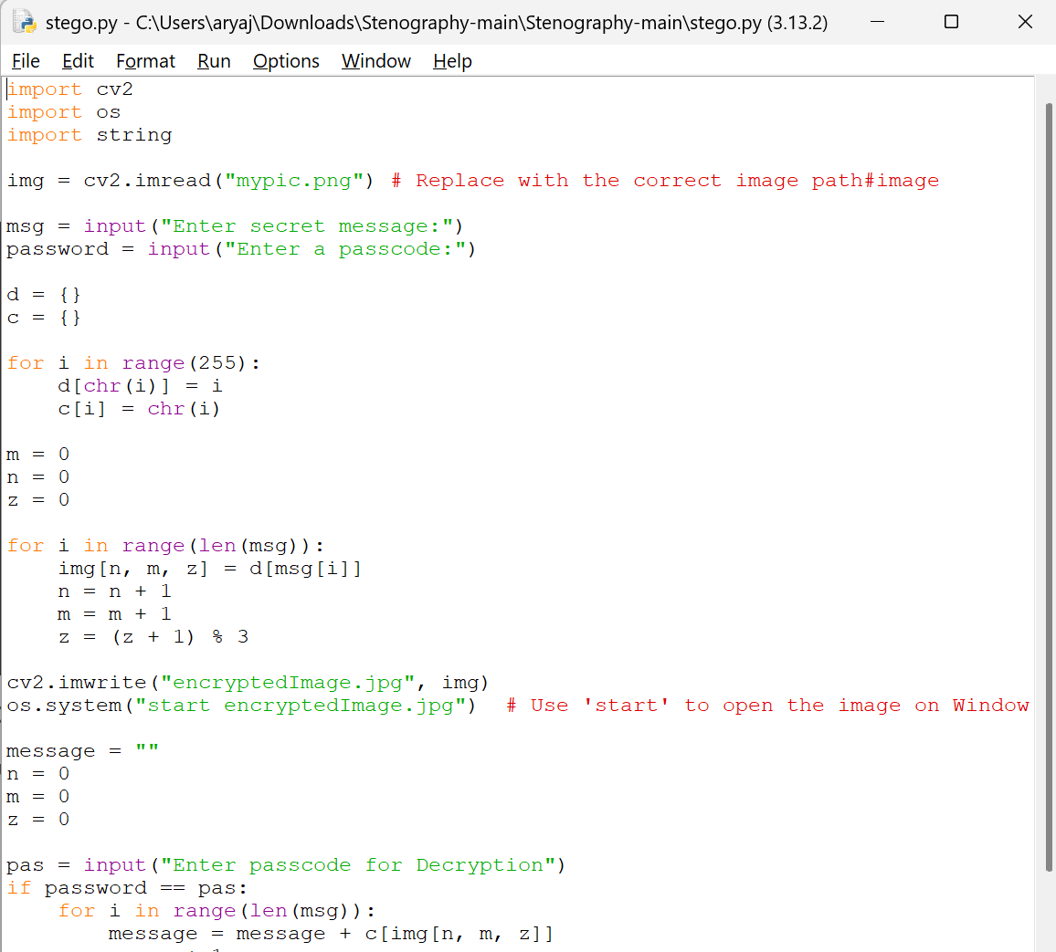

Results
This is the given code of the project and output generated in an encryptedimage form.

Slide 8
Conclusion
Encoding private information into pictures in a way that is imperceptible to the naked sight, the Secure Data Hiding in Images Using Steganography project showcases a potent technique for safe communication and data security.
Steganography and encryption work together to provide double-layer security, which makes it impervious to discovery and unwanted access.
This project offers a flexible way to safely transfer data while preserving image quality, with applications in a wide range of industries, including cybersecurity, business, government, and personal use. In the end, it offers a covert, safe, and effective means of sharing and safeguarding private data.

Slide 9
GitHub Link
https://github.com/MedInTim3/AICTE_MAHESHJADHAO_steganography.git

Slide 10
Future scope(optional)
Real-time Data Hiding for secure live communications.
Higher Data Capacity through more efficient embedding algorithms.
Reversible Watermarking for content protection and authentication.
Blockchain Integration for tamper-proof, decentralized data security.
AI-driven Analysis for automated detection and recovery of hidden data.

Slide 11
THANK YOU

